Slide 1
Home Credit Default risk
Credit policy maker presentation
Tri Nguyen
May 12, 2020

Slide 2
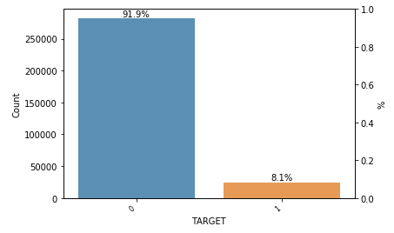
Credit default 8%, ~2% over market average. Opportunities to refine credit policy…
Source: Application_test.csv
Recommendations:
Consider # of active credits one of important criteria
Loosen credit policy for customers with at least ONE active mortgage
Refine the policy to give loans to previously rejected applications
Refine income requirements for loan applications
Notes:
First, let’s look at why we are here.
Our credit default rate is at 8%, 2% over market average. This presented an opportunity to explore low-risk segment and how to be more prudent in term of choosing our current group of customers.
In short, our recommendations are below… I will walk you through the supporting findings that helped us come up with these recommendations

Slide 3
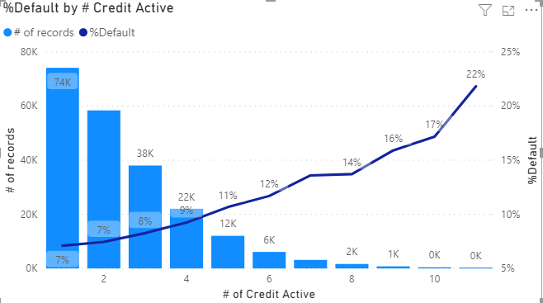
# Of active credit is an important criteria in approving loans…
Source: Application_test.csv, Bureau.csv
The higher the applicant’s number of credit actives, the higher the default rate.
Make # of active credits one of important criteria in loan application review.
Tighten the policy for customers with >2 active credits.
* # of active credit cannot be the only factor to deny loan applications
Notes:
First of all, a little disclaimer… One feature only cannot be a basis to deny or reject a loan application.
The first learning of all, # active credit seems correlated with default rate. Higher the # of active credits, the higher chance of default. Starts with 1 at 7% and each 1 increasement in # active credit, 1-2% increase in default rate.
To reduce %default rate, we suggest you look into tightening the policy for customers with more than 2 active credits because customers with at least 3 active credit have higher than current average % default.

Slide 4
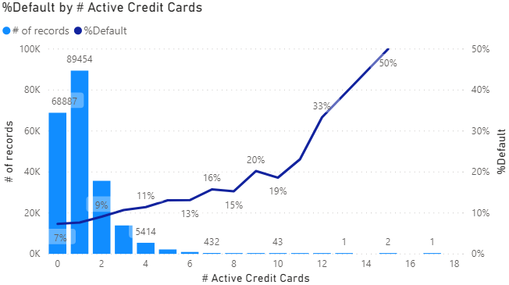
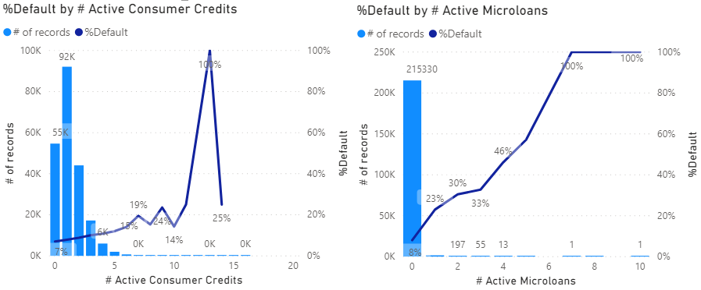
high number of any active credit indicates higher chance of default, except…
Customer with at least one microloan have at last 23% chance of default.
Source: Application_test.csv, Bureau.csv
* # of active credit cannot be the only factor to deny loan applications
Notes:
When we look closer into type of active credits, we see the same patterns across the board for different types of credits. Microloans is also very risky. Customers with 1 active microloans have 23% chance of default.
This pattern happens for all credit types, except 1…

Slide 5
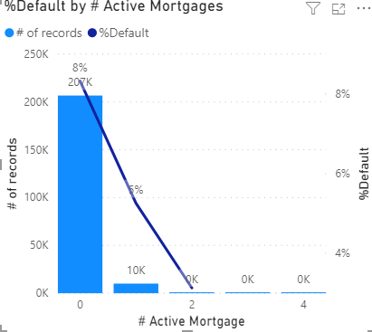
… Except active mortgages…
Source: Application_test.csv, Bureau.csv
The higher # of mortgages, the lower chance the customers have difficulties in making payments.
# of current customers with at least one mortgages is low.
Loosen criteria for applicants with >1 active mortgage.
Notes:
Mortgages have different direction. The higher # of active mortgages, the lower chance of default. Customers with 1 active mortgage have only 5% chance of default. More than that, the default rate drop to 0.
Also, we don’t have a lot of customers with active mortgage and this seems to be a safe segment to explore. We suggest to look into loosen criteria for applicants with at least 1 active mortgage.

Slide 6
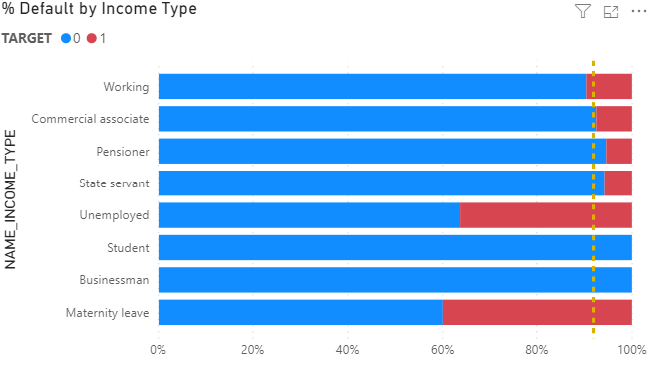
Tighten the criteria GIVING loans to temporary inactive income applicants…
Source: Application_test.csv
Students and Businessman have low default rate
Unemployed and Maternity leave have higher default rate
* Income type cannot be the only factor to deny loan applications
Notes:
This chart show % default by income types…2 things that stand out: Unemployment and maternity leave people have higher chance of default. These are temporary inactive incomes, to differentiate with pensioner (also in active income, but not temporary). As I said earlier, income type only cannot be the ground for loan rejection. However, we suggest you look closer to the income requirement for inactive incomes. Students and Businessman also have low default rate although the # of records are not high enough to say certain that they have 0 default rate.

Slide 7
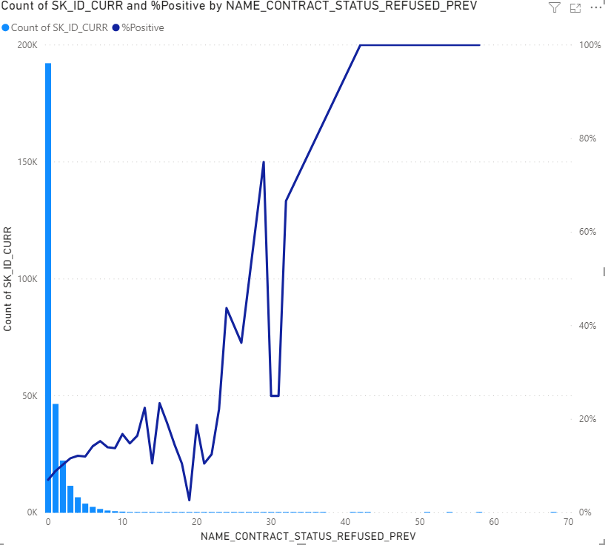
Trust our instinct!
% Default by # of Previously Refused applications
Source:
Application_test.csv
Previous_application.csv
Only 0-rejected applications have below average default rate (7%).
The higher the # of previously rejected applications, the higher chance of default.
# of Previously Refused applications
Review the approval criteria for previously-rejected applications.
* # of rejections cannot be the only factor to deny loan applications
Notes:
Last but not least… You have done a very good job of detecting credit defaults and avoiding people with low chance to pay back. We need to continue doing that and trust your instinct more.
This chart show that people with previously rejected applications have higher chance for defaults… the higher the number of rejection, the higher % default.
We suggest your team to review the approval criteria for previously-rejected applications.

Slide 8
Recommendations
Relook at customers’ active credit count and their approval criteria
Loosen the criteria giving loans to applicants having at least 1 active mortgage
Review approval criteria to give loans to previously rejected applications
Tighten income requirements for applicants with inactive income
Notes:
These are the recommendation. We mentioned at the beginning of the presentation, but we put them again here.
4 things:
Any questions?

